Slide 1
The Gauge
The Gauge

Slide 2
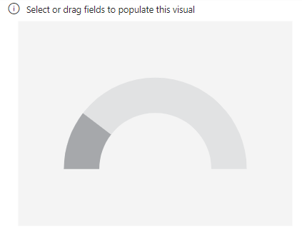
The Gauge
Note: This lab is using Sales database in resources
Add a Gauge visual to the scene

Slide 3
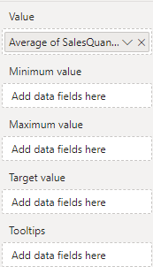

The Gauge
Add Average SalesQuantity to Value and observe the changes

Slide 4
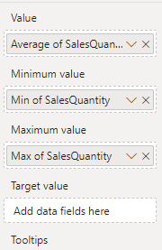
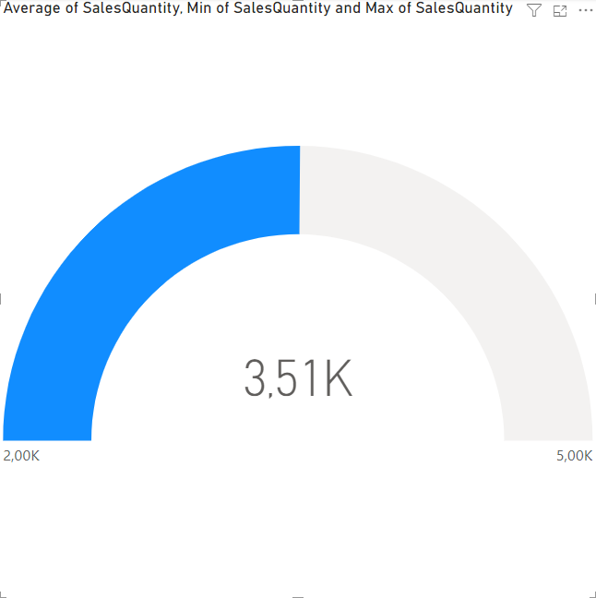
The Gauge
Add Minimum and Maximum SalesQuantity respectively to Minimum Value and Maximum Value and observe the changes
Before
After

Slide 5
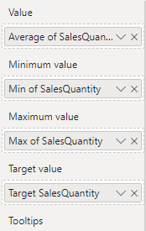
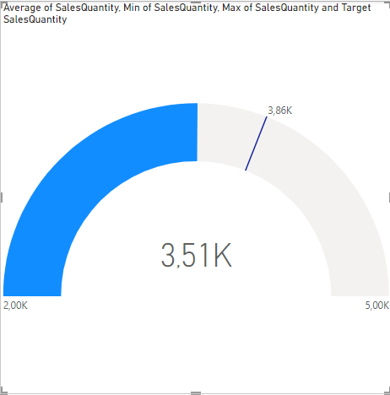
The Gauge
Add Target SalesQuantity measure and observe the changes
Target SalesQuantity = AVERAGE(FactSales[SalesQuantity])*1.1

Slide 6
The Gauge
Edit DimDate in Power Query Editor, and derive Date column from DateKey column using Column from examples feature
Create a measure as follow
Test = CALCULATE(AVERAGE(FactSales[SalesQuantity]),FILTER(DimDate,DimDate[Date]<DATE(2018,4,1)))
Put Test measure instead of Avearge SalesQuantity in the Value and try to change dates values then observe the Gauge visual behavior
Test = CALCULATE(AVERAGE(FactSales[SalesQuantity]),FILTER(DimDate,DimDate[Date]<DATE(2019,4,1)))

Slide 7
Thank you
Thank you

